Slide 1

CODER HOUSE
CST 4TH SEMESTER
Ashikur R Ashik

Slide 2
WEB Devlopment
1.HTML
2.CSS
3.BOOTSTRAB
4.Javascript

Slide 3
HABIGANJ POLYTECHNIC INSTITUTE.

Slide 4
PRIMARY GOALS
৪র্থ সেমিস্টারে বেসিক শেষ করা

Slide 5


Tag

Slide 6
Groups rules
১.প্রতি দিনের কাজ প্রতি দিন করতে হবে
২.সাপ্তাহে দুই দিন গুগল মিটিং করা হবে ( Friday && Saturday)
৩. সাপ্তাহে কিছু মডিউল দেয়া হবে সেটা সময় মতো শেষ করতে হবে
৪.যারা কাজ নিয়ে সিরিয়াস হবে না তাদের কে মেইন গ্রুপে এড দেয়া হবে না
৫.যে দিন মিটিং হবে সে দিন রাত ৯ টায় হবে ( সবার সুবিধা দেখে সময় দেয়া হবে )

Slide 7
আজ তুমি যেখানে আছো, সেটা তোমার অতীতের কর্মফল। কিন্তু কাল তুমি যেখানে পৌঁছাবে, সেটা তোমার আজকের কর্মফল।
“
”
Coder House

Slide 8
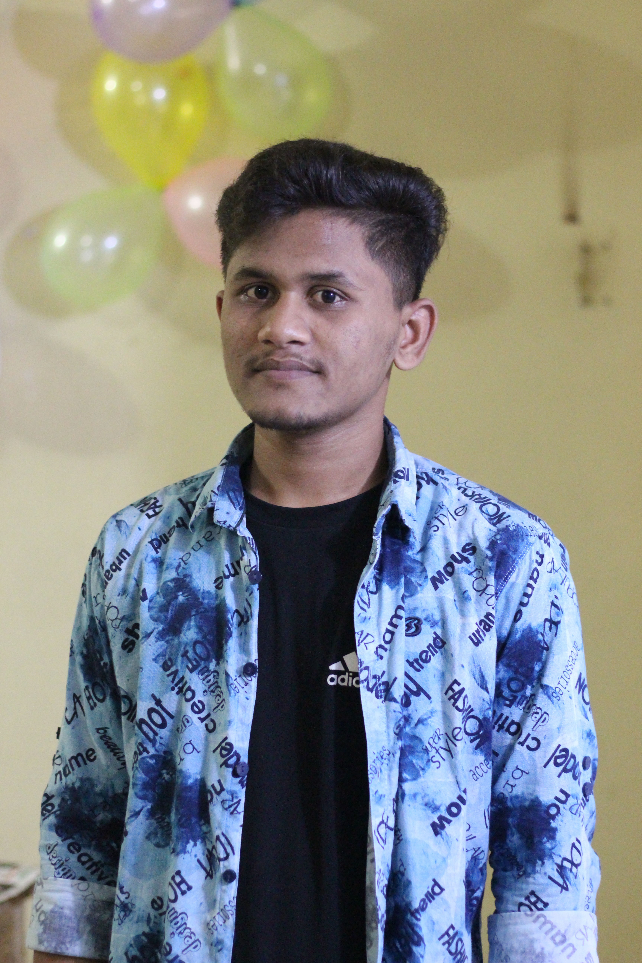

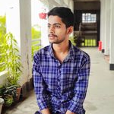
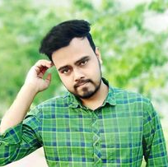
MEET OUR TEAM
ASHIKUR R ASHIK
Rohul amin
Uzzal kumar dash
Rasel boss
ADMIN
Member
Chief Operations Officer
Trainer by coder house

Slide 9
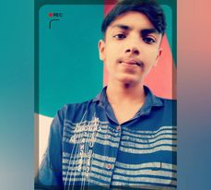


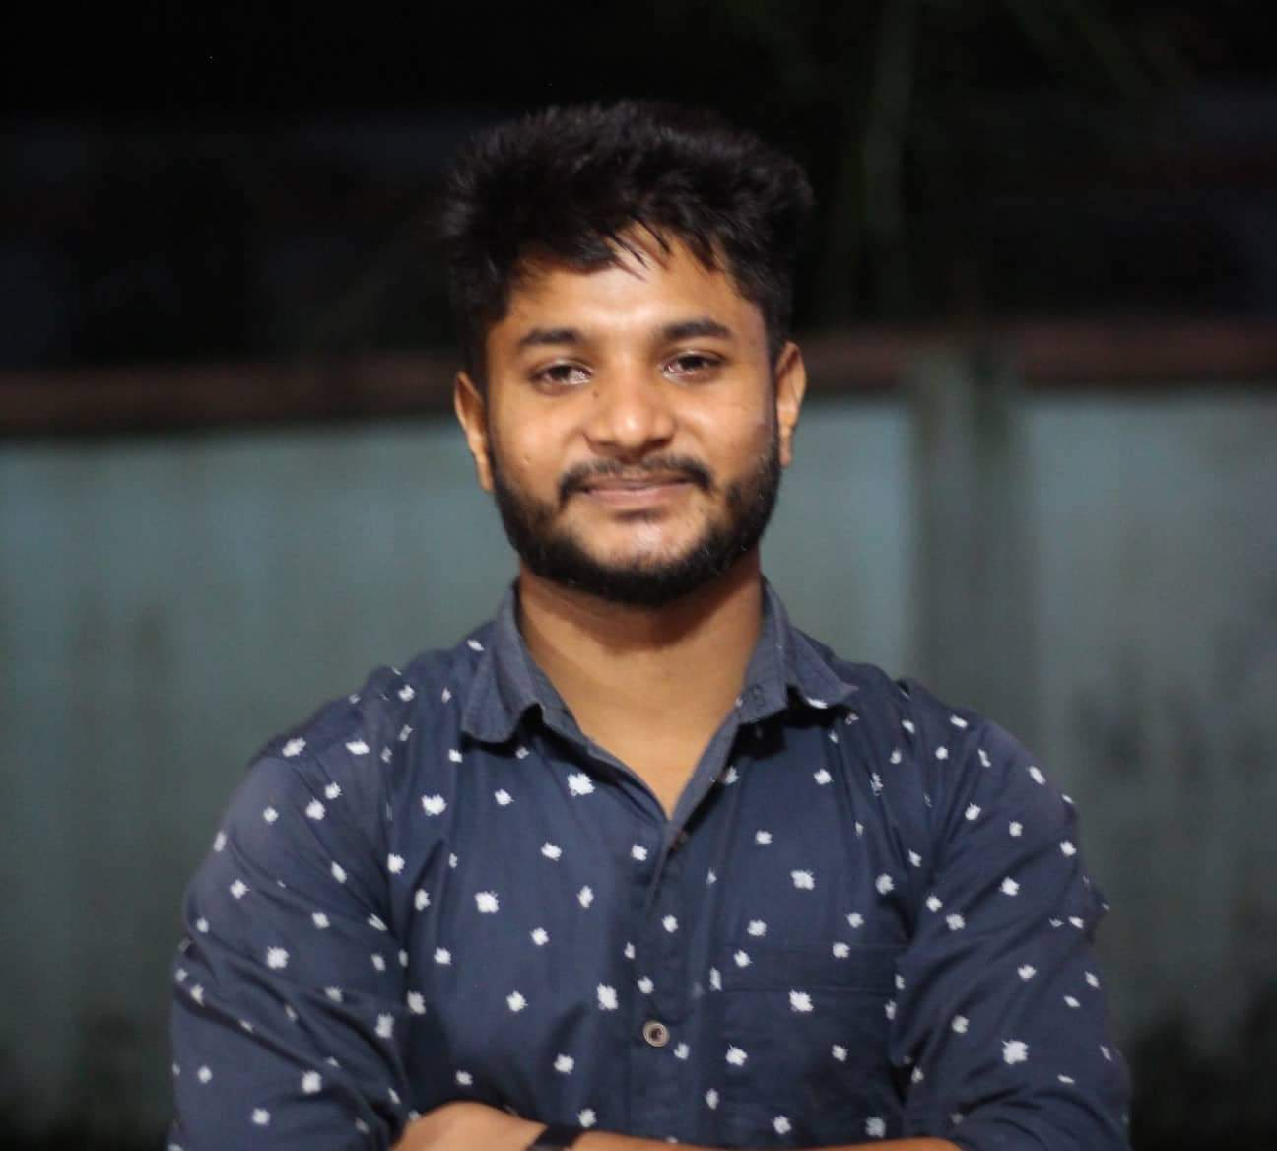


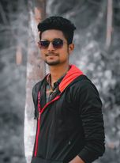
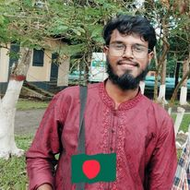
MEET OUR Extended TEAM
Rijvi ahmed
Shamim miah
Arman ​
Atikur Rahman
member
member
member
Shahdat h siam
Jahidur Rahman
utsho
Sumon ahmed
Member
Member
member
Member

Slide 10





PLAN FOR web development
PLANNING
MARKETING
DESIGN
STRATEGY
LAUNCH
Synergize scalable e-commerce
Disseminate standardized metrics
Coordinate e- business applications
Foster holistically superior methodologies
Deploy strategic networks with compelling e- business needs

Slide 11
TIMELINE
SEP 20XX
NOV 20XX
JAN 20XX
MAR 20XX
MAY 20XX
Synergize scalable e-commerce
Disseminate standardized metrics
Coordinate e- business applications
Foster holistically superior methodologies
Deploy strategic networks with compelling e- business needs

Slide 12
AREAS OF FOCUS
B2B MARKET SCENARIOS
CLOUD-BASED OPPORTUNITIES
Develop winning strategies to keep ahead of the competition
Capitalize on low-hanging fruit to identify a ballpark value
Visualize customer directed convergence
Iterative approaches to corporate strategy
Establish a management framework from the inside

Slide 13



HOW WE GET THERE
ROI
NICHE MARKETS
SUPPLY CHAINS
Envision multimedia-based expertise and cross-media growth strategies
Visualize quality intellectual capital
Engage worldwide methodologies with web-enabled technologies
Pursue scalable customer service through sustainable strategies
Engage top-line web services with cutting-edge deliverables
Cultivate one-to-one customer service with robust ideas
Maximize timely deliverables for real-time schemas

Slide 14
SUMMARY
At Contoso, we believe in giving 110%. By using our next-generation data architecture, we help organizations virtually manage agile workflows. We thrive because of our market knowledge and great team behind our product. As our CEO says, "Efficiencies will come from proactively transforming how we do business."

Slide 15
THANK YOU
Mirjam Nilsson​
mirjam@contoso.com
www.contoso.com

